Slide 1
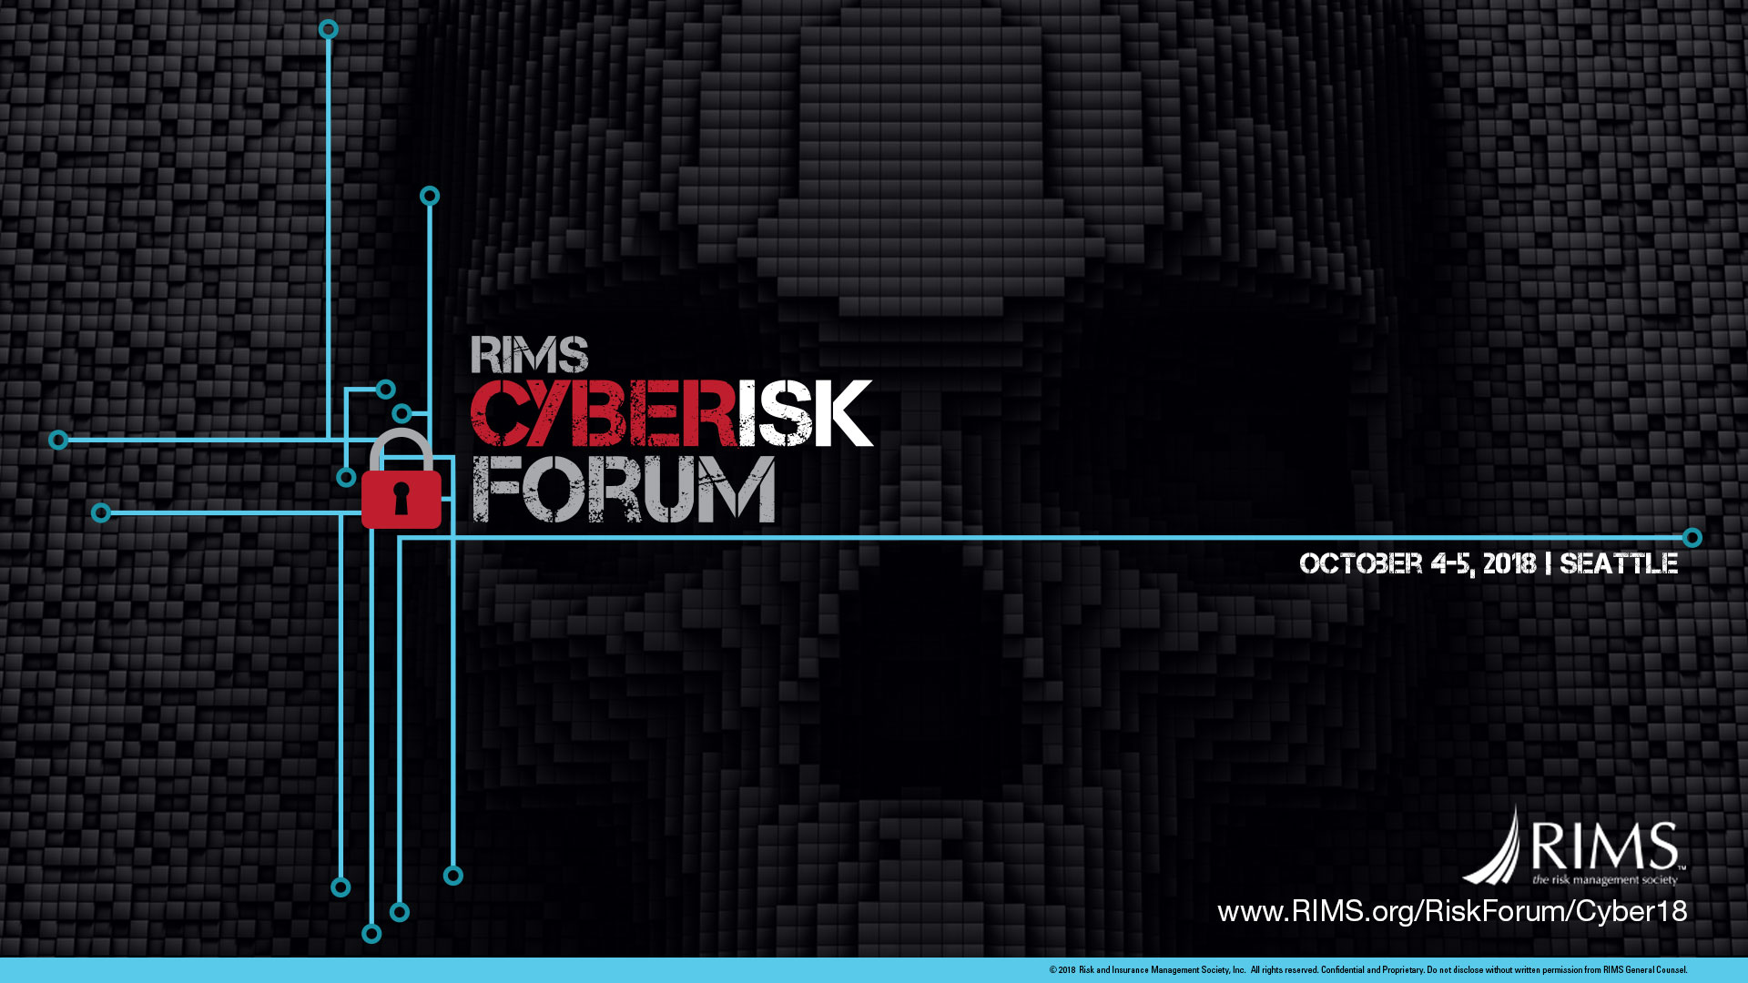

Slide 2
Why Companies Fail During a Cyberattack
Steven Wertheim, President SonMax Consultants Inc.

Slide 3

Biography
As president of SonMax Consultants Inc., Steven leads, develops, and grows the firm’s relationships with enterprise clients, helping them to manage and control risk and security postures. His robust history in global sales, consulting, and business development positions SonMax for success.
Before SonMax, Steven served as a VP/Client Executive at Stroz Friedberg, where he led the financial services vertical. Earlier, he was Global Client Sales Executive at HP Enterprise Services, where he provided leadership and support in strategy, sales architecture, and business development, as well as technology and services solutions for enterprise clients.
Earlier in his career, Steven held lengthy tenures with Bankers Trust and Chase Manhattan Bank. As a VP/Division Executive at Chase, he played a pivotal role in the Money Transfer division, and received the president’s citation for excellence in that field.
Steven is a Grumman scholar.
E: steven.wertheim@sonmax.com T: +1 732.591.1512 x101 F: +1 732.591.5424 www.sonmax.com

Slide 4

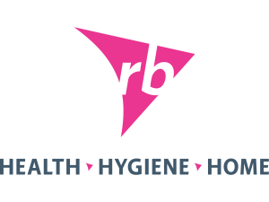



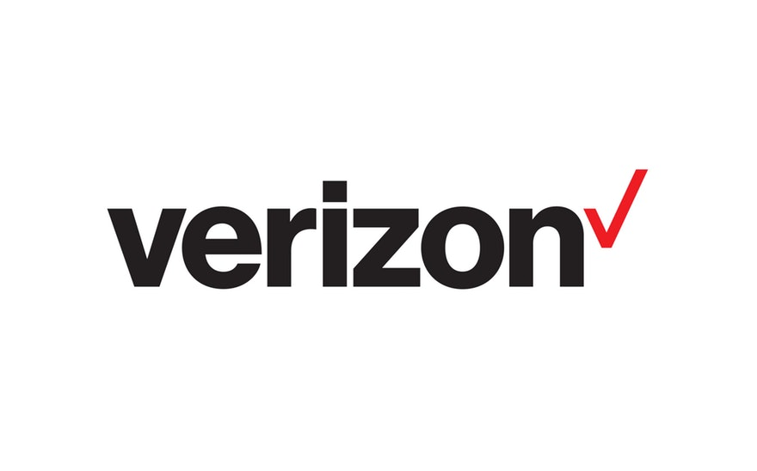






























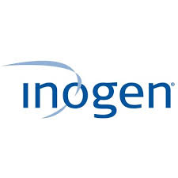











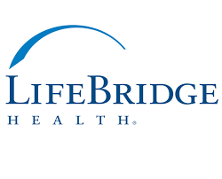


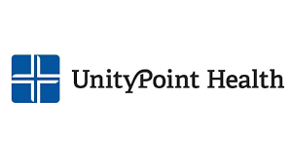




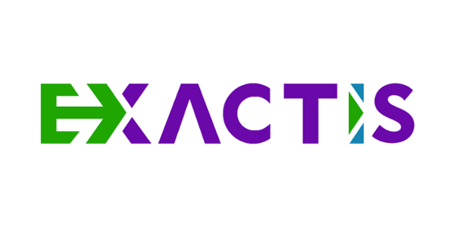




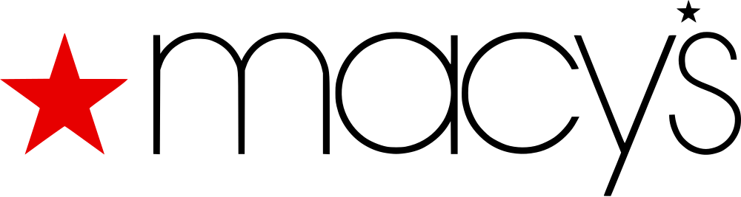
The List is Endless
Notes:
The list is endless: Here are just some of the organizations hit by major data breaches over the last 18 months:
Cybercrime, globally, cost over $2T last year and is forecast to rise to $6T by 2021 – that translates into an average of a 43% YOY increase for each of the next 3 years and represents the biggest transfer of economic wealth in history. At $6T, Cybercrime will represent ~7% of the world-wide GDP and will be, by far, the 3rd largest component of world economy after the GDPs of the US and China. US Ransomware costs have grown from $25M in 2014 to over $5B in 2017 and is showing no signs of stopping. Ransomware attacks occur every 14 seconds. Ginni Rommety, IBM’s Chairperson, CEO and President, stated that “Cybercrime represents the greatest threat to every company in the world”
Yet we ignore the issue or pass the back – saying that it’s a complex technology problem. To quote Albert Einstein, “The definition of insanity is to do the same thing over and over and expect different results”. To continue to claim that cybercrime and cybersecurity are technology problems, as cybercrime grows at better than 40% YOY, fits Einstein’s assertion.

Slide 5

Notes:
According to a GAO audit, released just last month, government agencies, including the Federal government are failing to adequately address cybersecurity risks, jeopardizing not only the operations of the federal government, its agencies and local governments but also the personal information of U.S. citizens.
The report, called Urgent Actions Needed to Address Cybersecurity Challenges Facing the Nation, notes that of the more than 3,000 recommendations the agency issued since 2010, 1,000 have not been implemented as of August. In addition, 31 of 35 priority recommendations also haven’t been addressed.
A single ransomware attack took down ALL of Atlanta's services, including: Fire, Police, 911, City offices, and transportation.

Slide 6
Why are companies failing?
Lack of Business Focus/Buy-in/Engagement
Inadequate Resourcing/Training
Inadequate Understanding of Risk
Inadequate Monitoring
Lack of Incident Response Plan
Lack of Updating and Testing of IRP
Lack of 3rd Party Support
Notes:
Why are companies failing so badly?
No venture INTENDS to fail:
What goes wrong?
Lack of business focus
Inadequate resourcing
Inadequate monitoring
Lack of understanding of organizational risk – and how that risk specifically impacts the business
Sometimes, lack of an IRP
Often, lack of an updated IRP
Lack of testing of the IRP to uncover weakness and remediate them
No 3rd party support in place to respond quickly and help remediate the consequences
Context:
Lack of business focus: When an event occurs, the Information Security Team and/or the Information Technology team immediately go into fire-drill mode. They begin attacking the problem with the full technological clout available to them. Too often, these efforts remain siloed from the rest of the business; or the business is ping the IT and ISO teams to find out why critical systems may not be working or dealing with public reaction to the incident. Instead of acting as a coherent team, with common messaging and strategies, the situation becomes more chaotic, not less (think Equifax)
Inadequate resourcing and training: Companies too often view incidence response as “sunk cost” to the business that has no benefit to the bottom line –it’s taking money, time and people away from building and driving revenue. Hmm, how does BA feel about the potential €547M GDPR fine based upon exchange rates on 12 September (12.2B GBP in 2017 worldwide revenue). BA’s profits for last year were 3.015B Euros. So we’re looking at 18% of BA’s profits being wiped out. When training is done, it is typically done on with the IT and IS organizations and not beyond.
Inadequate understanding of the risks: How many organizations really understand the level of risk in the environment? How often do companies perform a cybersecurity framework risk assessment? Too often, it’s not done enough. As I speak to CISOs, CSOs and other risk executives, the most frequent response to “What keeps you up at night” is “I have no idea where my most critical data reside”. In speaking with the CEO of an investor relations firm, I asked her about her risk, and she replied, “Oh, my IT guy takes care of it.” When I asked her “how do you know that?”, she could not answer me. In 2014, during a conference on cyber-security, the CIO of a company got up at the outset and challenged the speaker, claiming that the CIO’s firm was fully secure and could not be penetrated and challenged the speaker to prove him wrong. The speaker took the challenge, texted his hacking team and by the Q&A, had a list of confidential information from the CIO’s company. In 2016, a clothing manufacturer contracted for a Pen Test. The challenge was to do a social engineering pen test at a secure site, accessible only via card-key locked doors. The team successfully penetrated the most secure systems in the company, including their mainframe, in less than 2 hours, without using a SINGLE technology tool.
Inadequate monitoring: The technical tools aren’t lacking but the unified training as to why the tools provide critical support to the environment; what parts of the infrastructure represent the greatest risk to the business and how to mitigate those risks is missing
Lack of an incident response plan: This is primarily a problem in small to mid-sized companies. However, the size of the company does not obviate the risk. In the US, 70% of cyberattacks are aimed at small to medium-sized companies, covering 50% of the landscape. According to FEMA and the National Cyber Security Alliance, as much as 60% of small to mid-sized companies that are attacked go out of business after 6 months. There are approximately 217,000 businesses between $10M and $500M of annual revenue. That means in excess of 65,000 businesses can be expected to fail due to a cyberattack. [Talk about the ripple effect (insurance, b2b hits, etc.)]
Lack of updating and testing of the IRP: Once clients have an IRP, they tend to check off the compliance box, put the plan on a shelf and don’t bother looking at it again UNLESS there’s an incident. That leaves organizations with IRPs that do not reflect the current business environment, responsibilities, regulatory requirements (think GDPR), or staff. “Jennifer Smith”, the executive-in-charge of the IRP left ACME Products 3 years ago ad infinitum. [This will be expanded]
Lack of 3rd Party support: The CIO/CSO of a large NY-based credit union shared his nightmare experience with me when we first met. He described the helpless panic he felt in negotiating a deal with a world-class response firm for the first 72 hours after a major data breach his the CU. He talked about his lack of leverage in negotiating ANYTHING with the 3rd party, all while his firm was front-page news in 2 newspapers and a lead article on evening newscasts. It was the worst 72 hours of his professional career.
I have no doubt many of you are feeling a bit skeptical about some of this. So let’s look at a real world example from a white-glove financial services firm:

Slide 7
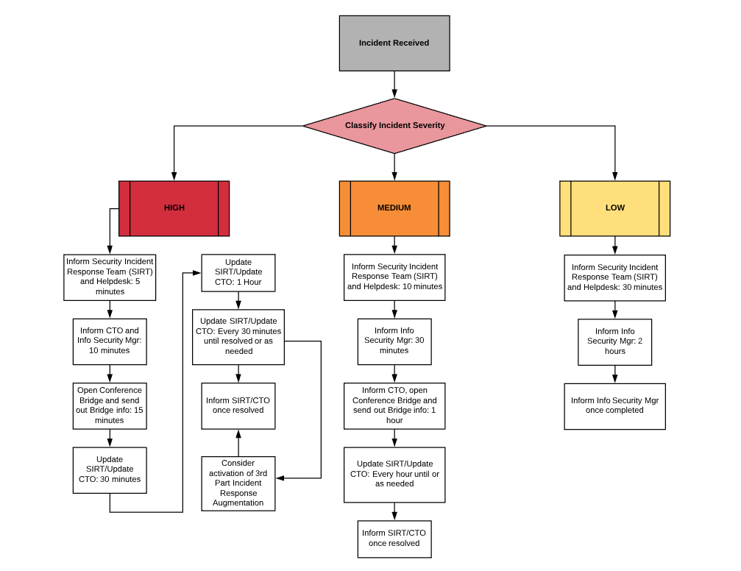
Incident Response
Too many single points of failure
Classification?
Why only “consider” activating 3rd Party?
Notes:
Here is a typical Incident Response process chart. This chart, based on a real client’s IRP, was redacted to eliminate anything that would divulge the identity of the client. All of the process and decision boxes are exactly as crafted by the client.
At first glance, one could easily presume that the client has done a good job in defining key parameters around multiple types of incidents, but there are many, major errors.
First, the client determines, upon notification of the incident, that the incident has either a high, medium or low level of severity. That determination is impossible to make upon initial notification. Only a detailed forensic activity can determine how severe an incident WAS. All incidents must be presumed to be of high severity at the outset.
Additionally, being notified of an incident does not mean that the incident just happened. The FBI and other industry forums advise that the average dwell-time, i.e.; the time from the incident occurrence to the identification of the incident, is approximately 217 days. After each 100 days of dwell-time, the COST of the incident doubles. This is a cross-industry average and may not reflect all verticals. [MyHeritage]
Third, too many single-points of failure appear embedded within the process. Note, that that CTO is a designated update layer for all issues, on a regular basis. There is no indication that there is anyone in the organization who can function in the absence of the CTO. And the Security Team Manager is a second SPOF.
Further, the client “considers” activating the 3rd party Incident Response Augmentation – meaning that they have a 3rd party firm on retainer to support them – but they only wish to consider activating that retainer. Why? Best practice dictates that one should have as many objective eyes on the problem, as quickly as possible, to help mitigate the damage from any incident.
Next, this process chart heavily focuses on “informing” and “updating”. At no point in this process is anyone actually making any key decisions. For instance:
When does the team decide to contact law-enforcement?
When does the team craft a message to the Board of Directors and the Press (or in the case of a privately-held firm – when does the team engage the investors?)
When does the team bring in a 3rd party forensics team?
Who is responsible for managing the news flow?
Next, and this is vitally important, the client presumes that this entire incident is a technology problem. There is absolutely no engagement with any part of the organization that deals with the business; no contemplation of the potential impact to the operations of the business or the financial impact to the corporation. Nothing in this chart addresses how the business will inform and interact with the public; no definition of lines of communications
Now apply the following real-world scenario to the flowchart:
It seemed like just another ordinary day for a small online retailer in the Midwest. Little did they know that the simple click of an e-mail link was about to threaten the entire business. One of the company’s employees received an e-mail with a link to a seemingly benign catalog. One click and the company’s system was infected with Crytowall malware that affected accounting software, customer account files, including credit card numbers, social security numbers, customer names and addresses among other information.
The accounting software and customer files did not live on the employee’s computer; it lived on the company’s network drive, so the malware was able to encrypt 15,000 accounting and customer files. A ransom email soon followed, demanding $50,000 in exchange for a decryption key. The company’s backup systems had not been working for months, and with the virus proving impossible to remove without the loss of crucial company data, the company had no choice but to pay up.
But the decryption key didn’t work. Business came to a standstill. The owner could not afford to pay to rebuild the network systems. Six months later the company closed its doors, strangled by lack of sales and cashflow.
Where do these real-world events fit into the Incident Flowchart you see before you? They don’t.

Slide 8
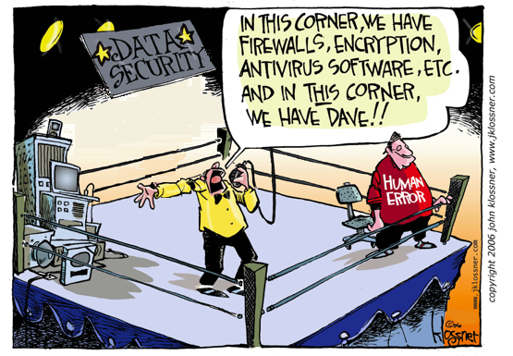
It’s Not About The Tools
Notes:
If this were primarily a technology problem, the big financial service firms and technology firms would NEVER be hit. Yet they are. If this were only a technology problem, cybercrime would not be growing as fast as it is.
It’s about the human factor that underpins so much of the risk that enables the cyberattacks and allow them to succeed. And Dave isn’t just a 400 lb. guy in his mother’s basement. Dave is a nation-state with comprehensive cyberwarfare teams. Dave is a criminal organization intent on stealing all they can. And Dave is a hacktivist/anarchist, trying to disrupt all technology life. They don’t care whom they hurt – only that they get what they want.

Slide 9
It’s Not About Hiding
Notes:
It’s about recognizing that ignoring the problem does not solve anything – The GC who infamously said in response to a report about 30,000,000 at-risk client-PCI records “Well, if the hammer comes down, I will just resign and get a job elsewhere” doesn’t fix anything for anyone.

Slide 10
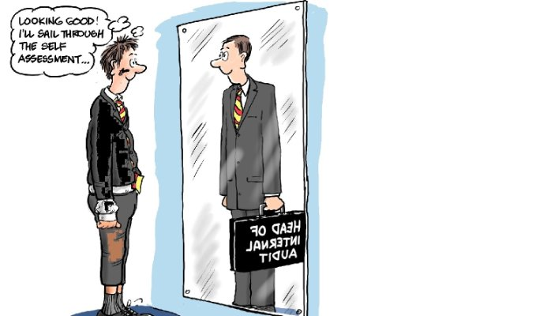
How do we fix this?
Get Business focus/Buy-in/Engagement
Adequate Resourcing and Training of Staff
Understand the Risk
Effective Monitoring
Have an Incident Response Plan
Update and Test the IRP
Engage a 3rd Party Support Organization
Notes:
How to fix this.
Business focus: Incident Response is a VITAL requirement for Corporate health. It is a function that should report to the CEO and/or the Board. It should be treated as a primary fiduciary responsibility by the Board and executive team. Everything should be about the business. Cybersecurity needs to be viewed as business issue; not a technology issue. Only the Board and CEO have the power to mandate that all these historically siloed teams work together. And everyone, from every silo, must speak with a single voice.
Adequate resourcing: An IR team needs to be constructed to serve the needs of the business. To do that, the team must have stakeholders and representatives from all parts of the business: Executive team, Board, business, compliance and legal, IT, etc. Also, there never, ever should be a single point of failure in any aspect of how this operates. (tell stories). Training is key. The only way to get organizations to understand the impact of these risks is to provide training on the impact.
Understand the risks: Asses the risk of your environment on a regular basis. Identify the risks and look closely at which risks are most critical. Here’s an easy one – GET RID OF PASSWORDS. Password controls as currently structured, are a failure – and that’s not just me saying it but those are the words of Bill Burr, a manager at the National Institute of Standards and Technology (NIST), who wrote the password primer in 2003 that recommended many of the rules we have now. Mr. Burr now concedes that it was a mistake and that the current paradigm INCREASES not decreases risk. Some form of MFA should be mandatory (Biometric, registered device, etc.). Here’s another easy one – patch security flaws in a timely fashion – yes, there is much regression testing that needs to be done and one patch can sometimes break production applications. But consider, the NonPetya/WannaCry(pt) day-zero patch was released in March of 2017 and companies waited between 3 and 18 months to patch – at a cost of over $10Billion worldwide. I strongly suspect that the $348+M lost at Reckitt-Benckiser is far greater than the cost of a short-term production failure.
More active and effective monitoring: Once an organizations UNDERSTANDS the risks, then one can effectively deploy the tools to better monitor the areas or risk. Further, best practice dictates that an organization should have a pre-defined plan to do periodic Security Framework Assessments. This means using best-of-breed 3rd Party tools to do a deep-scan of the entire enterprise. Whether you opt to do it yearly, twice-yearly, quarterly or continuously, know your timeframes. With a cross-industry average of ~220 days of dwell-time, make an informed decision on how long you can afford to leave and incident uncovered.
Build an incident response plan: Ensure that your IRP is a fully cross-functional plan with multiple resources from each of the following:
The executive suite
HR
Legal/Compliance
Business-side
Customer Service
IT
IS
Service Desk
SIRT
Marketing
Communications
Make sure you include links to shareholders, the Board and if private, your investors. Empower the plan to help you get in-front of the bad news, as opposed to responding to the flurry of media requests. A key goal of the IRP is to help support ALL parts of the organization are speaking with a single voice. Do not allow yourselves to devolve into a blame game. Instead, work the problem. (Apollo 13 story goes here).
Update and test the IRP regularly: Your business is not static, and your IRP always reflects your business. Build in the appropriate collaboration tools to support updates to your plan at least once a year. And TEST your plan. When you test your plan, stress it to TRY to make it fail. You will always learn far more for your plan failures than you will from a smooth no-issue test. And remember, the goal is not to blame – the goal is to find any embedded weaknesses and remediate them quickly. When the real event occurs, a tested and updated plan will always assist you in recovering faster and at a far lower cost than otherwise.
3rd Party support: Establish a retainer agreement with one or more forensic/response firms. Having an independent objective view is a critical element in developing a complete picture of the who/what/why of the incident. 3rd Parties never make assumptions, assumptions we automatically make about our own business. (show pic) – Work with your 3rd party support organization to do an annualized security audit

Slide 11
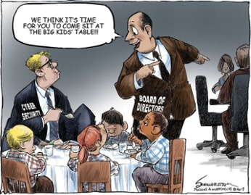
It’s About Business…
And It’s Not Easy; But Is Doable
Notes:
It’s about making cybersecurity part of the fabric of the business.

Slide 12
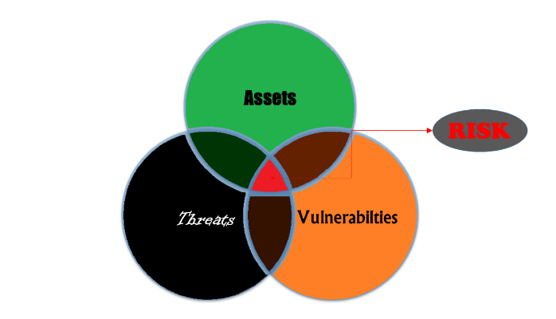
Questions?

Slide 13
Thank You

